Slide 1
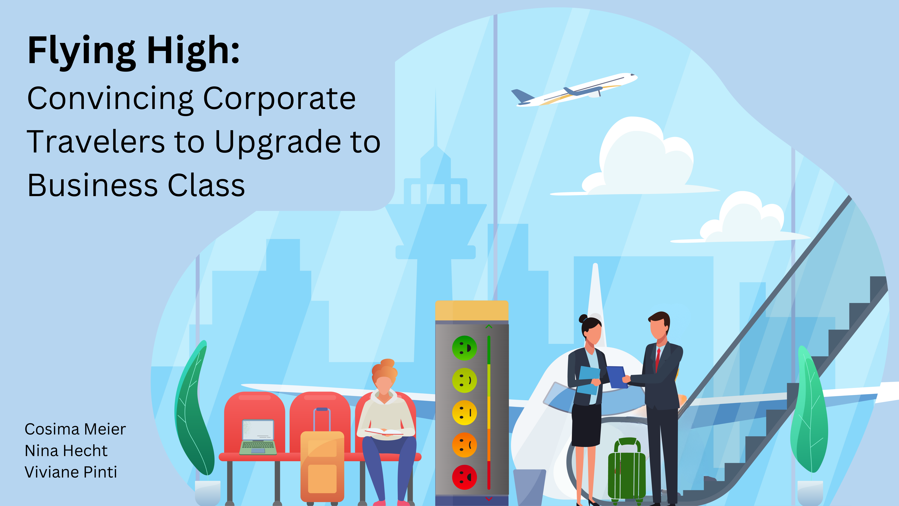
Notes:
Hi ,everyone! We are excited to share and discuss with you our data analytics project. The title of your project is: Flying High: Convincing corporate travelers to upgrade to business class. This titel already alludes to our objective. However, before delving into further details, let me first explain the rationale behind our approach.

Slide 2
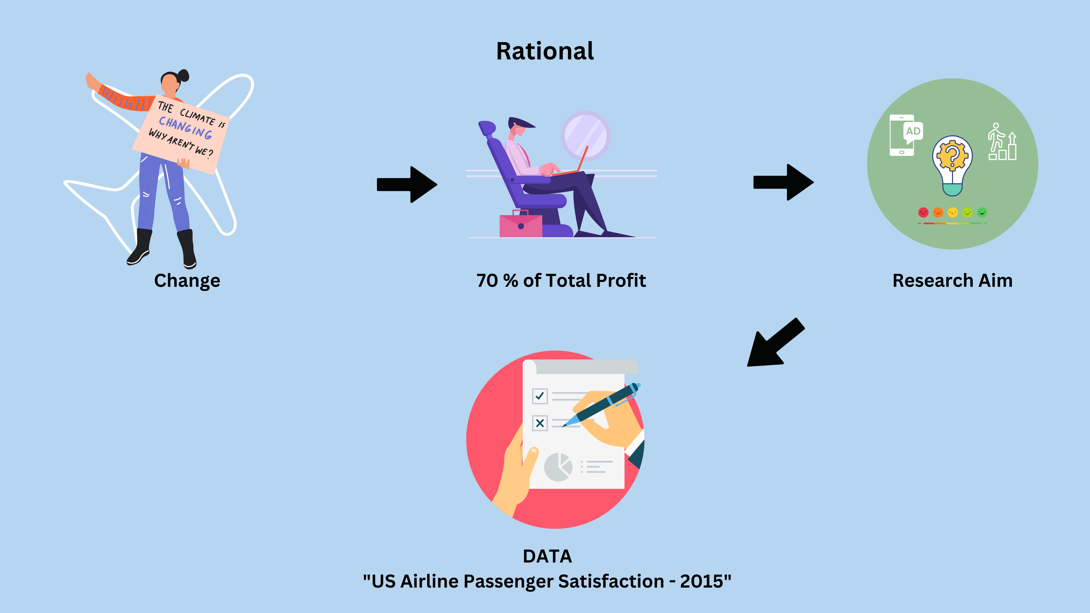
Notes:
Climate change and the corresponding mitigation actions also have an impact on the aviation industry by potentially reducing air travel. This is because individuals may become more aware of the CO2 impact of flying on global warming. So, there might be a decrease in the number of customers, leading to increased competition among airlines. It is therefore crucial for airlines to gain a competitive edge by ensuring that their customers are satisfied.
One important customer segment to consider is corporate travelers. These individuals not only continue to travel for specific business reasons but also contribute up to 70% of total profits by flying business or first-class Interestingly, not all corporate travelers choose to fly business class; some opt for economy class. However, since business class services are tailored to meet the needs of business travelers, there may be a potential loss of profits and satisfaction. This brings us straight to our research aim.
Our aim is to identify which services should be marketed to corporate travelers flying economy class in order to encourage them to upgrade to business class. By doing so, we can enhance passenger satisfaction, provide the airline with a competitive advantage, and increase profits. It is important to note that we don’t aim to improve the services.
To answer this research question, we worked with the US Airline passenger Satisfaction Data set from 2015. This dataset includes ratings of 14 air travel services on a 5-point likert scale, as well as additional information about each passenger, such as their class and type of travel. In total about 130’000 individuals particpated in these surveys.

Slide 3
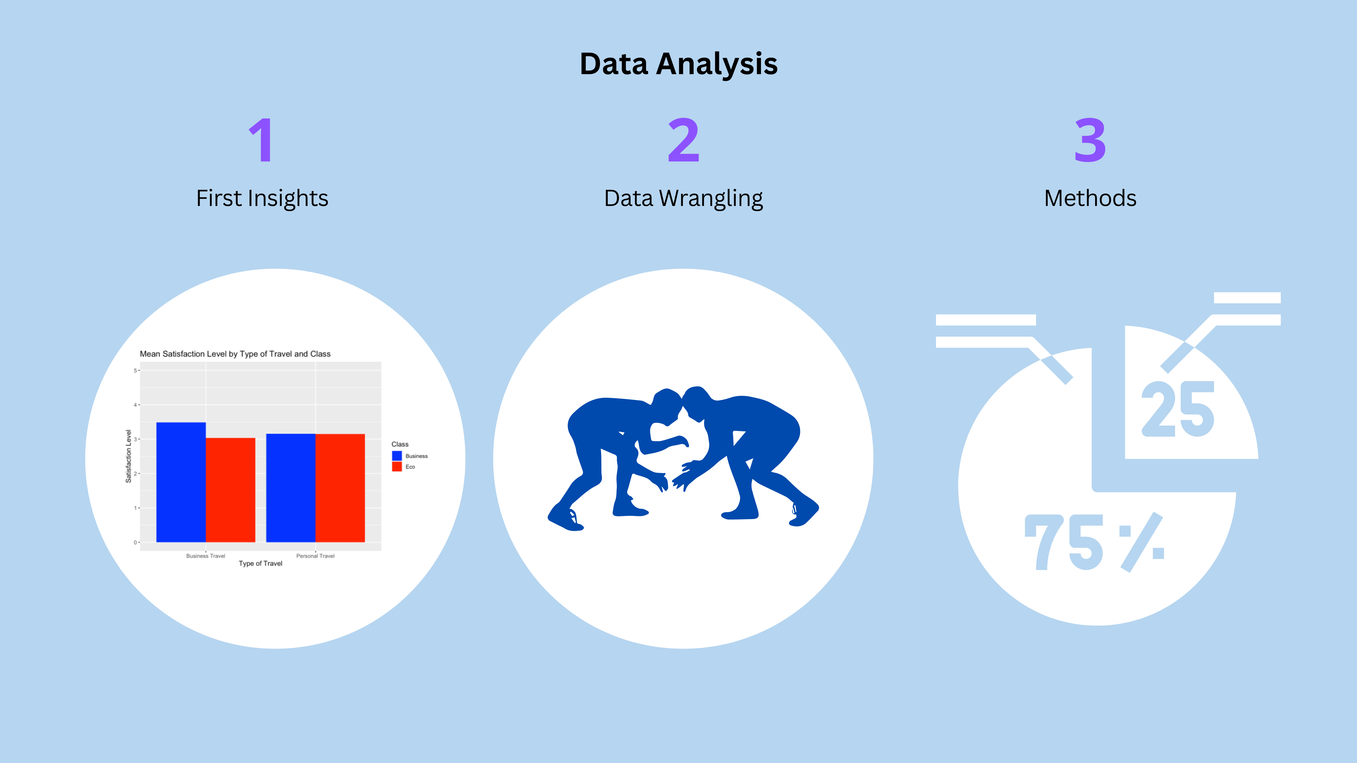
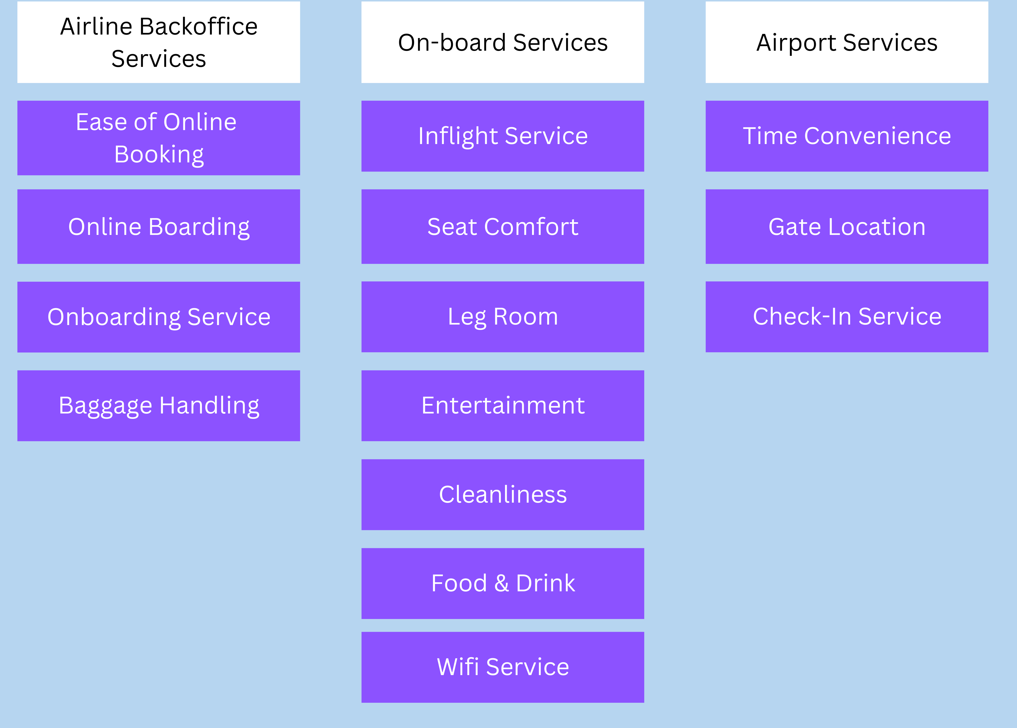
Notes:
First, we took a closer look at our data. We started by looking at the difference in average overall satisfaction between corporate and personal travellers in Business and Economy Class. This led us to one of our first findings, which is also consistent with the existing literature and speaks to our research question: our data showed that corporate travellers in Economy Class were less satisfied than personal travellers in Economy class, but they were more satisfied in Business Class than personal travellers in Business Class. This means that the needs of corporate travellers are not fully met in Economy Class and that they would be more satisfied with an upgrade to Business Class. (You can see these differences in the first graph).
Next, we did some data wrangling. Since our initial analysis confirmed that we needed to focus on corporate travellers, we only worked with Business class passengers who travelled for work reasons and excluded all personal travellers from our analysis. We then analysed the missing data, which ranged from 0 to 5%, with a mean of 0.8%. More importantly, we created subgroups for our variables. As we can see here (show categories), we divided them into 3 categories including airline backoffice services, on-board services and airport services.
For our main analysis, we first focused primarly on inferential statistics and calculated means, effect sizes and conducted significance tests. With Rui and Dirk's inputs, we quickly learned that a different approach, one closer to our data, was a much better suited approach to answer our research question.

Slide 4
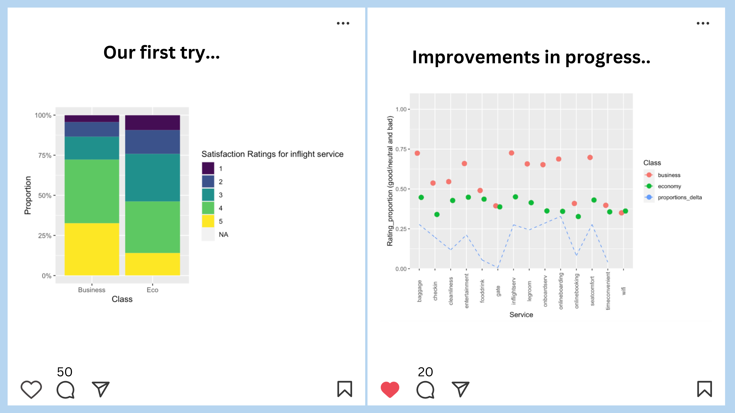
Notes:
Having learned that data analysis is not just about statistical significance, we switched to calculating passengers’ satisfaction rates. On our journey to answer our research question, we tried out many plots. Here you can see some examples of them. On the left hand side, we have tried to show the different proportions of satisfaction ratings divided by class, but only for one variable. As we can see, there was a lot of feedback on this plot. On the right hand side, we see an improvement on our first idea: the concept of calculating ratios has been kept, but now we summarized the satisfaction rates and showed the differences between good and neutral or bad satisfaction ratings. We also found a way to present all 14 variables in the same graph. As a result, the graph was also more appealing.

Slide 5
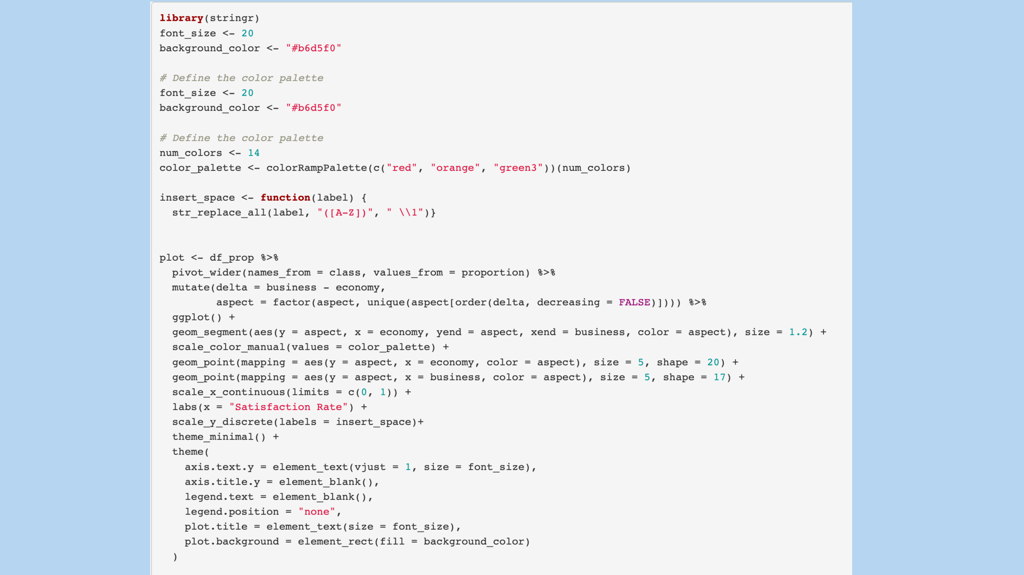
Notes:
Next, we would like to take a closer look at our final plot.
Here you can see the code for our final plot. Let's go through it step by step. We will only go into the most interesting parts.
First, we defined the color palette for our plot. And it is a color gradient from green to red.
The next section of code we used to get the labels all in the same style at once. We first had labels that were written end to end and wanted to separate them, so we added a space and continued with a capital letter.
Now the code for the actual plot begins. First of all, we have mutated the order of the labels according to the delta. That is, the largest delta should be at the top and become smaller towards the bottom.
At the next arrow you can see the code for the visualization of our plot. The special thing about it is that we used "geom_segment" for it. In our plot, we wanted to show the satisfaction ratings of the economy class on the one hand, but also those of the business class and connect these two points with each other. That's why we used geom_segment.
First, we have defined the x and y normally here. On the y-axis we have Aspect. This variable stands for the different services. On the x-axis is economy, which is the class. Next in the code is "yend", which is the second point on the Y-axis. Again, we want the point at the corresponding service, therefore aspect. And xend is the business.
Now we would like to show you our final plot.

Slide 6
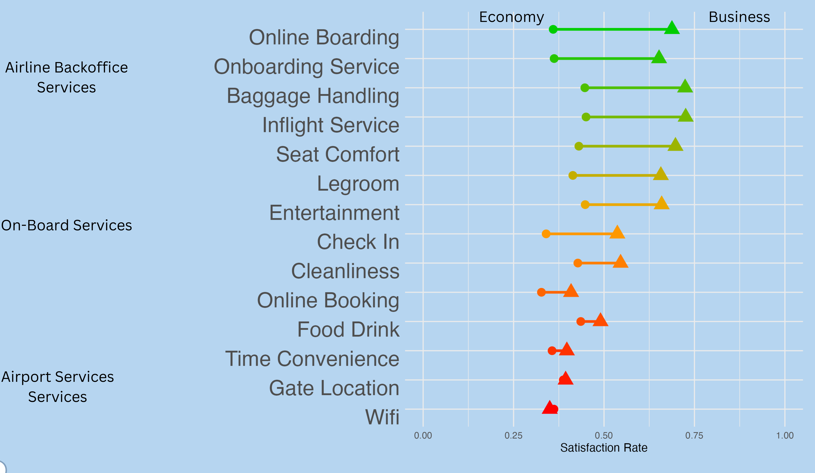
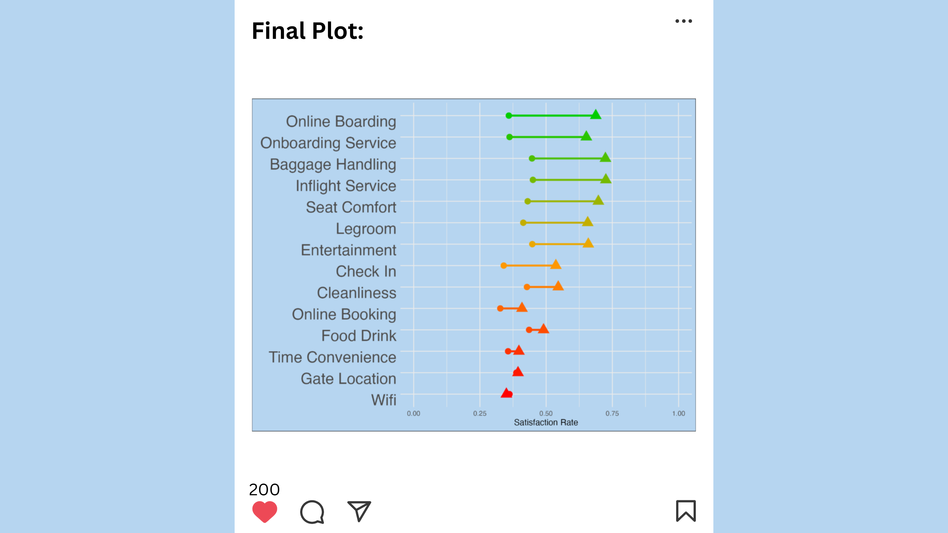
Final Plot
Notes:
We presented our findings in a plot, where services are ranked by the size of the difference in satisfaction levels between economy and business class, which is indicated by the colour gradient (from green to red).
Let's take a closer look at the first service: Online boarding.
About 30% of corporate passengers in economy are satisfied or very satisfied with online boarding. Shown with a dot in the graph. In business class, on the other hand, almost 75% of corporate travelers are satisfied or very satisfied with online boarding. There is therefore a big difference between economy and business class. Consequently, corporate travelers in economy class could be persuaded with marketing activities to upgrade to business class, as their needs in terms of online boarding are much better addressed here
We recommend spending the marketing budget on the airline backoffice services, as they show the greatest difference in satisfaction rating.
This plot also shows that advertisers should not spend marketing ressources on airport services, as it would not convince corporate travelers in economy class to upgrade to business class.
This translates to increased profitability for the airline, while at the same time ensuring higher satisfaction among corporate passengers. It's a win-win scenario.

Slide 7
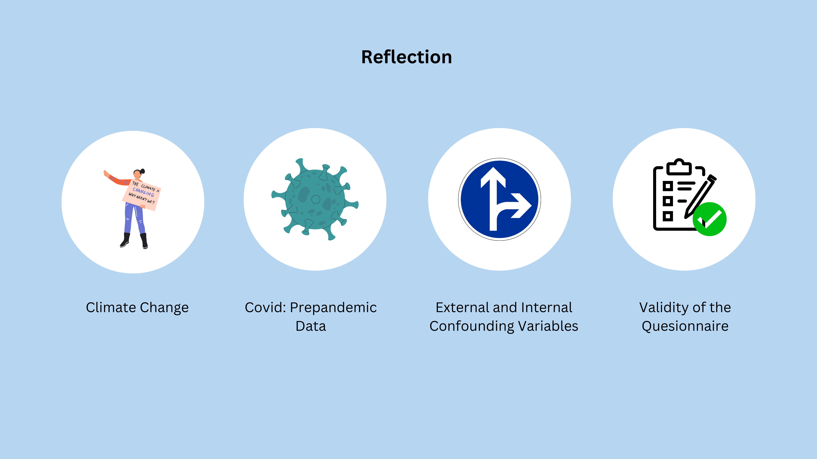
Notes:
During our project we encountered several challenges.
Firstly, it was difficult to integrate the perspective climate change into our research aim as our goal was not to reduce air travel. So we struggled with that quite a bit.
Secondly, a limitation of our results is that the data set that we used is from 2015 so its precovid data. That’s an issue because airtravel might have changed quit a bit in the last couple of years.
Another limitation was that we did not consider all external and internal confounding variables such as socioeconomic status, purchasing power; flight distance and what the services acutally entail
And finally, we weren’t able to assess the Validity of the questionnaire
Overall during the project, we had a great time and fun working together as a team and we learned a lot.

